Slide 1

CH 42010: PROCESS PLANT OPERATION & SAFETY
LTP: 3-0-0, CRD: 3
Lecture 6
Plant Test Runs and Rating Calculations

Slide 2
PLANT TEST RUN (PTR)
PTR: a controlled trial or assessment conducted in an industrial plant to evaluate the performance, efficiency, and safety of the equipment, systems, and processes under actual operating conditions.
During a PTR, the plant operates at specific conditions—often at full capacity or under varying loads—to collect data on key parameters such as temperature, pressure, flow rates, and product quality.
The primary purposes of a PTR include:
Validating Performance: Ensuring the equipment and systems meet the design specifications and performance criteria.
Troubleshooting & Optimization: Identifying any operational bottlenecks, inefficiencies, or potential areas for improvement.
Quality Control: Confirming that the production process can consistently produce outputs that meet quality standards.
Safety Verification: Testing operational safety protocols and ensuring compliance with safety regulations.
PTRs are essential during the commissioning phase (when a new plant or equipment is being started for the first time) and for ongoing performance evaluations to maintain or improve efficiency and safety.

Slide 3
PLANT TEST RUN
Data Collection and Instrumentation
Importance of accurate data collection and selecting suitable sensors and instruments.
Calibration and validation of equipment before the test run.
Online and offline data collection methods.
Analyzing and Interpreting Test Run Data
Statistical analysis of collected data to identify trends and operational patterns.
Calculations for equipment rating based on operational data and thermodynamic principles.
Use of simulation software or tools to predict performance under different conditions.
Safety and Compliance During Test Runs
Ensuring that test runs are conducted safely, with all personnel trained on emergency shutdown procedures (ESP).
Compliance with regulatory standards, industry best practices, and environmental considerations.
Risk assessment to anticipate potential hazards associated with specific equipment.
Reporting and Documentation
Preparing comprehensive test reports that include methodology, data, analysis, conclusions, and recommendations.
Importance of documenting deviations from expected performance and troubleshooting approaches.

Slide 4
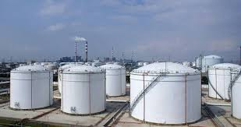
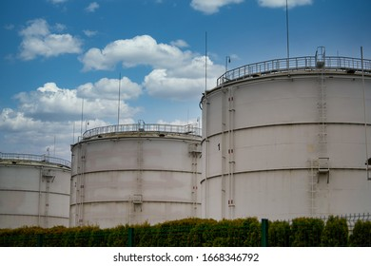
OPTIMUM DESIGN
Cost of sides: c_{s}
Cost of bottom: c_{b}
Cost of top: c_{t}
Q. You need to design a cylindrical storage vessel with diameter (D) of your choice. Evaluate the design criteria.
Source: Google Images

Slide 5
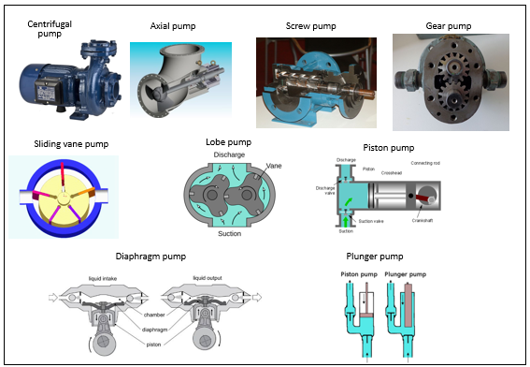
ROTATING EQUIPMENTS – PUMPS, COMPRESSORS, TURBINES
PUMPS
Pump is a machine to move or transport incompressible fluids.
Classification of Pumps:
Dynamic Pump:
May have 100% slips if the discharge valve is closed.
Therefore, no excessive pressure build up will occur if the discharge valve is closed.
The dynamic pump efficiency is lower than positive displacement pumps.
They have relatively high flow rates at relatively high operating speed with low maintenance costs.
Two types of dynamic pump are: a) Centrifugal pump, & b) Axial pump.
Source: Google Images

Slide 6
ROTATING EQUIPMENTS – PUMPS, COMPRESSORS, TURBINES
PUMPS
Pump is a machine to move or transport incompressible fluids.
Classification of Pumps:
Positive Displacement Pump:
Operate by forcing a fixed volume of fluid from the inlet pressure section to the discharge section of the pump.
They have relatively low capacity, operating at lower speed but able to produce higher pressure than dynamic pumps.
Therefore, if the discharge valve is closed, the pressure will increase and may damage the discharge pipe if pressure relief is not provided.
The positive displacement pump may be classified into: a) Rotary pump such as screw pump, gear pump, sliding vane pump and lobe pump, & b) Reciprocating pump such as piston pump, diaphragm pump and plunger pump.
Source: Google Images

Slide 7
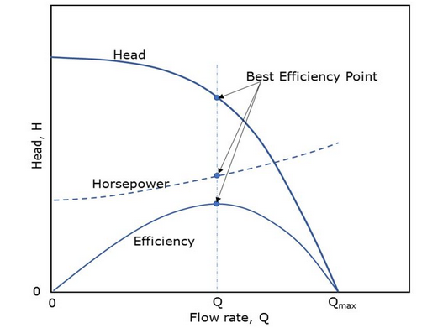
RATING CALCULATIONS – PUMPS
Two main criteria for pump selection are the capacity and pump head.
Manufacturers use pump head (in the unit of water height) instead of pressure for pump specifications.
The process designer has to calculate the required pump head when pumping a fluid from a location to another.
Then, one has to refer to the pump performance curve to select suitable pump for the operating condition.
The pump in the left figure is suitable at the operating condition (pump head, flowrate and horsepower) at the best efficiency point (maximum efficiency).
PUMP PERFORMANCE CURVE
Source: Google Images
Pump Head = Pressure Head + Elevation Head + Velocity Head + Pipe & Fittings Head

Slide 8
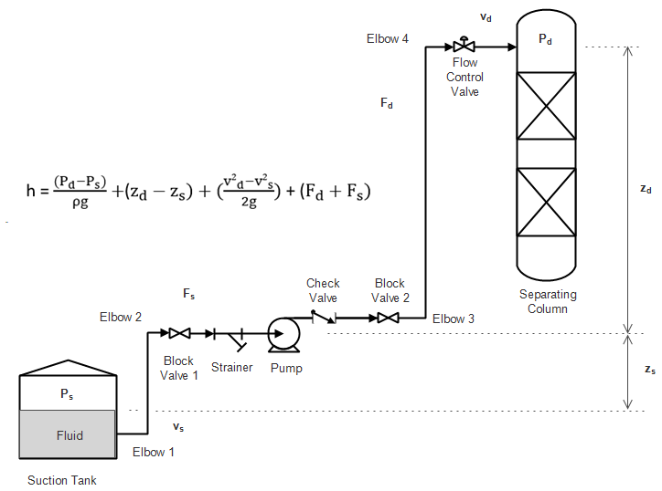
RATING CALCULATIONS – PUMPS
Pumps in series: Total discharge pressure is equal to the addition of the particular discharge pressures of each pump and the total flow is equal to the flow of one pump, which is the flow of the smaller pump (if the pumps are not of the same capacity).
Pump in parallel: Total discharge pressure is equal to discharge pressure of one pump & the total flow rate is the addition of the flow of each pump.
Source: Google Images

Slide 9
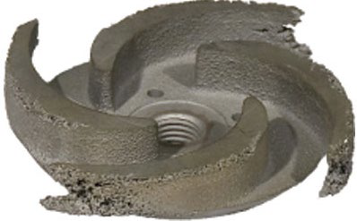
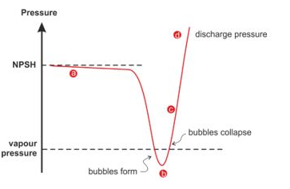
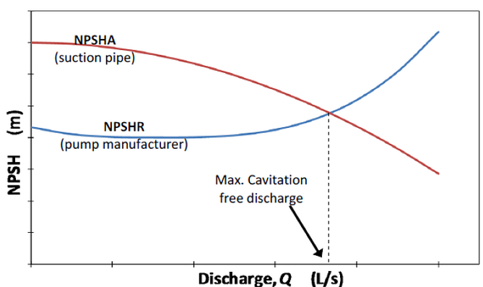
RATING CALCULATIONS – PUMPS
If the pressure of the pump < vapor pressure of the fluid, vapor will form.
As the fluid moves to the higher-pressure region, the bubbles will collapse and cavitation occurs.
The implosion of the bubbles may cause pitting to the impeller.
Cavitation is a common problem for centrifugal pump.
Cavitation on a Pump Impeller
The following techniques can be used to avoid cavitation in a pump:
Avoid low pressure if possible.
Pressurize the supply tank or increase the level of the supply tank.
Reduce the fluid temperature.
Use a larger pipe diameter to reduce minor losses in the suction pipe.
Use special cavitation-resistant materials or coatings.
Available net positive suction head (NPSHA) > Required NPSH (NPSHR).
The NPSHR is provided by the pump supplier or can be estimated using the graphical techniques from various literatures.
Source: Google Images
Source: Google Images

Slide 10
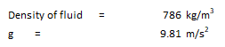
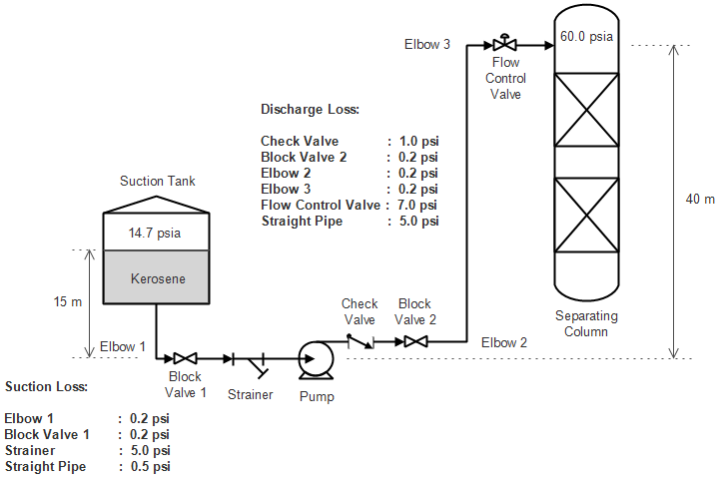
RATING CALCULATIONS – PUMPS
ASSIGNMENT
Q1. Calculate the required pump head (in meters) for the following system. The suction pressure is 14.7 psia (atmospheric pressure) and the suction fluid level is elevated 15 m from center of the pump. The calculated friction and fitting loss for suction and discharge pipes are given as in figure below. The discharge pressure is 40 psia and the level of the discharge fluid is elevated 40 m from the center of the pump. The pumping fluid is liquid kerosene. Since the suction level is above the pump center, it must be distracted with the Z_{d}, when using the equation. Head due to velocity is negligible. Use safety factor of 1.1 for the calculation.
100000 kg/m.s² = 14.504 lb/in²
Text Book: Introduction to Fluid Mechanics, Fox, McDonald, Pritchard

Slide 11
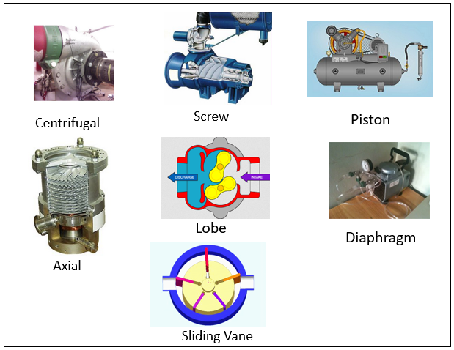
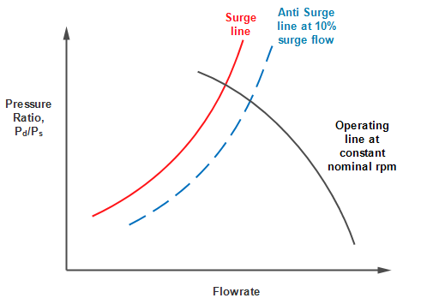
ROTATING EQUIPMENTS – PUMPS, COMPRESSORS, TURBINES
COMPRESSORS
Compressor is a machine to move or transport gas or vapor (Compressible Fluids).
Classification of Compressors:
Dynamic compressor
Centrifugal compressor
Axial compressor
Positive displacement compressor
Rotary compressor such as screw, sliding vane and lobe compressor.
Reciprocating compressor such as piston and diaphragm compressor.
Centrifugal compressor: surge is noisy unstable operation caused by periodic backflow due low inlet flow (flow < surge limit flow).
This unstable operation may cause mechanical damage and lead to major hazards.
To avoid surging, the compressor must always be operated above control limit (anti surge line). Control limit is the control line for the minimum flow at 10% of the surge limit.
If compressor surging occurs, operator should do the following immediately: i) Fully open the compressor by-pass valve (or recirculation valve) and ii) Close the compressor inlet valve to the minimum opening. Usually, the compressor inlet valve is mechanically locked at minimum opening.
Typical Surge
Compressor Curve
Source: Google Images

Slide 12
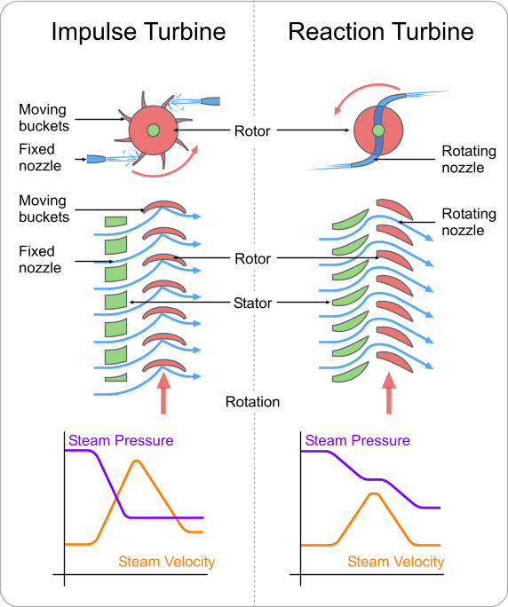
ROTATING EQUIPMENTS – PUMPS, COMPRESSORS, TURBINES
TURBINES
Steam turbines are widely used as prime movers, i.e., they are used to drive pump, compressor or electric generator.
Steam turbine is selected as the prime mover when a lot of steam is expected to be produced in a plant. Work is obtained through the expansion of steam.
Normally, a turbine will be backed up by electric motor prime mover.
Steam turbine converts steam/thermal energy into mechanical energy.
Both types of turbines can be:
Condensing: exhaust steam is condensed. Thus, the pressure is less than atm. pressure.
Non-condensing: exhaust steam is at pressure higher than atm. and used for other process.
Source: Google Images

Slide 13
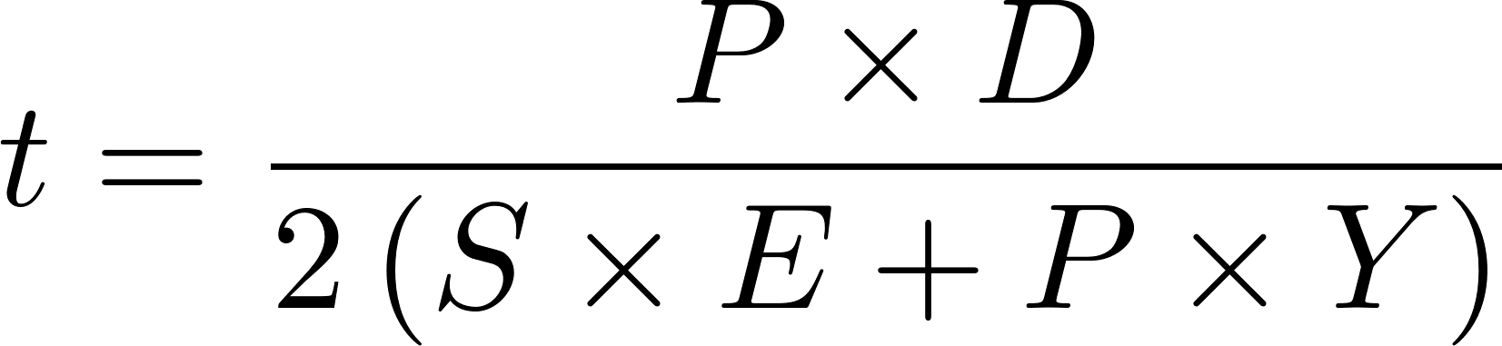

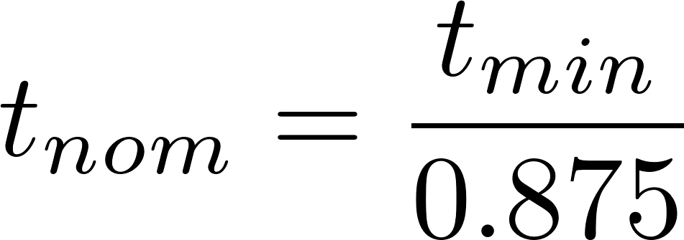
RATING CALCULATIONS – PIPES
Minimum Wall Thickness for a Pipe (ASME 31.3)
Minimum wall thickness of a process pipe for a specific internal pressure according to ASME 31.3 Code is given by:
P = Design pressure (psig)
D = Pipe outside diameter (in)
S = Allowable stress in tension (psi)
E = Longitudinal joint quality factor
Y = Wall thickness correction factor
tmin = Pipe thickness + Corrosion allowance
CA = Corrosion allowances
tnom = Nominal thickness

Slide 14
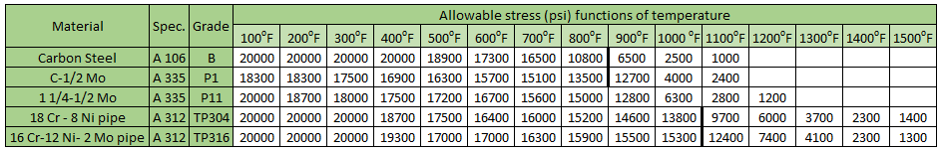
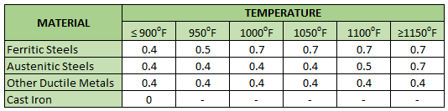
RATING CALCULATIONS – PIPES
Minimum Wall Thickness for a Pipe (ASME 31.3)
Determine the pipe wall thickness according to ASME 31.3 Code for the following conditions:
Design T = 800 °F.
Design P = 800 psig.
Pipe outside diameter = 10 in.
Material: Carbon Steel A106, Grade B, Seamless.
Corrosion allowance = 0.0625 in.
Allowable Stress at designated temperature (source: Carruci V.A., 2000)
Correction Factor
(source: Carruci V.A., 2000)

Slide 15
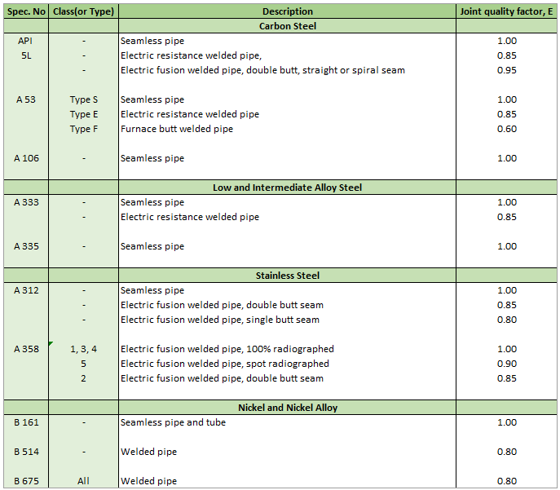
RATING CALCULATIONS – PIPES
Minimum Wall Thickness for a Pipe (ASME 31.3)
Joint Quality Factor
(source: Carruci V.A., 2000)

Slide 16
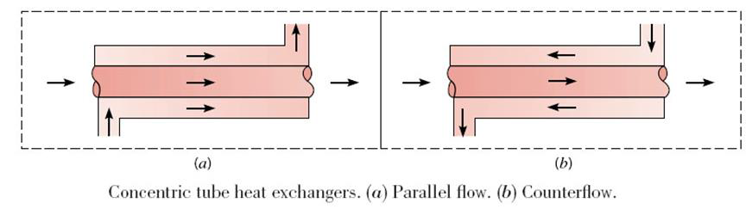
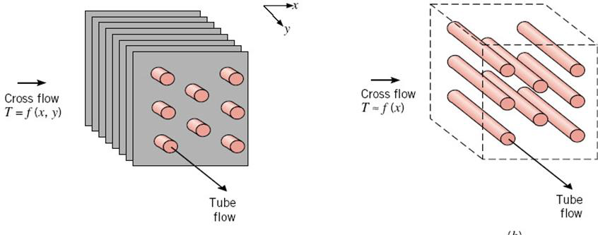
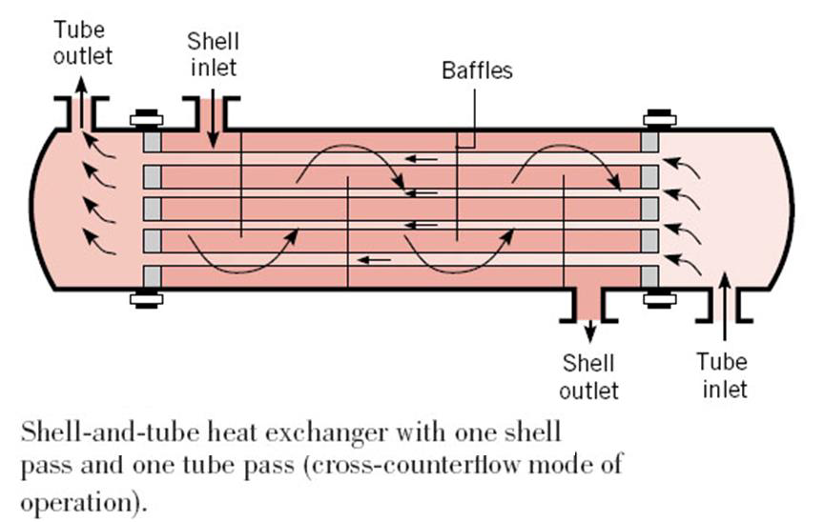
HEAT EXCHANGERS (HXs)
Devices used to exchange thermal energy between at least two fluids.
Cross flow heat exchanger (Finned, Unfinned)
Concentric tube heat exchanger
Parallel flow, Counter flow
Shell-and-tube heat exchanger
(One/more-tube and One-shell pass, Cross-Counter Flow Mode)
Source: Google Images

Slide 17
HEAT EXCHANGERS (HXs)
Devices used to exchange thermal energy between at least two fluids.
An engineer often finds himself or herself in a position:
to select a heat exchanger (Sizing) that will achieve a specified temperature change in a fluid stream of known mass flow rate: log mean temperature difference (or LMTD) method.
to predict the outlet temperatures of the hot and cold fluid streams in a specified heat exchanger (Rating): effectiveness (ε)–NTU method.
Shell-and-tube heat exchanger
(One/more-tube and One-shell pass, Cross-Counter Flow Mode)
Source: Google Images

Slide 18
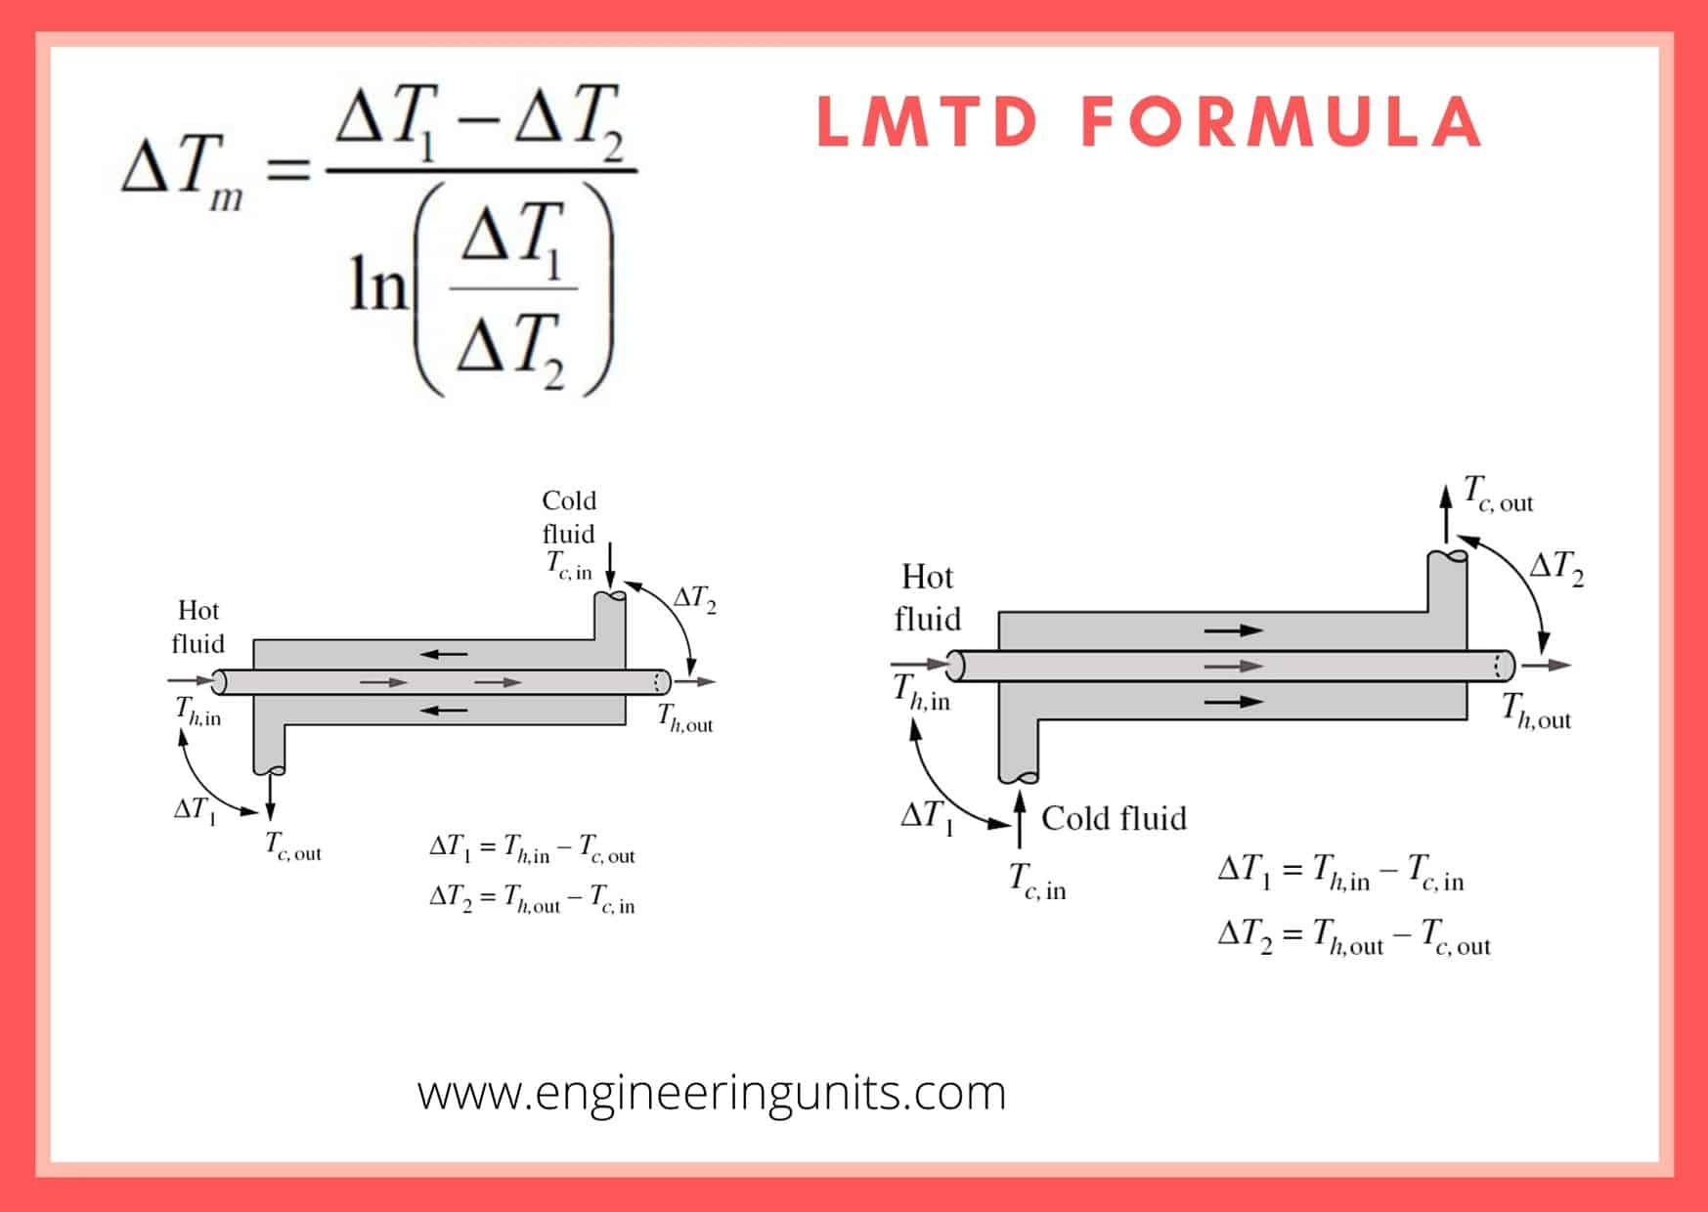


HEAT EXCHANGERS (HXs)
The main basic Heat Exchanger equation is:
Assumptions: a) Fully developed conditions, b) Constant cross-sectional areas,
c) Constant properties
The effective representation of temperature difference
Where:
A = Heat transfer area (m²) (ft²)
Q = Heat transfer rate (kJ/h) (Btu\h)
U = Overall heat transfer coefficient (kJ/h.m².°C) (Btu/h°F)
ΔT_{m} = Log mean temperature difference
Source: Google Images

Slide 19
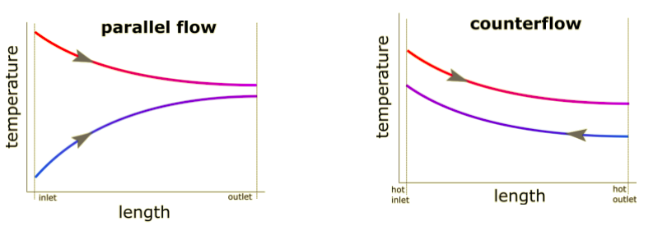
HEAT EXCHANGERS (HXs)
The effective representation of temperature difference
Counter Flow HX: This distributes the heat more evenly across the heat exchanger and allows for maximum efficiency. In theory, the cold fluid can exit the heat exchanger at a higher temperature than the temperature of the hot fluid outlet, although in reality this is very difficult to achieve.
Source: Google Images

Slide 20
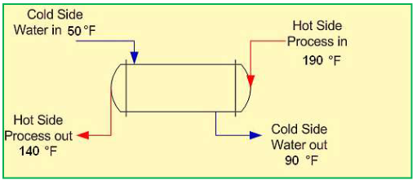
RATING CALCULATIONS – HXs
ASSIGNMENT
Q1. Estimate the heat exchanger area needed to cool 55,000 lb/h of a light oil (specific heat = 0.74 Btu/lb.°F) from 190°F to 140°F using cooling water that is available at 50°F. The cooling water can be allowed to heat to 90°F. An initial estimate of the Overall Heat Transfer Coefficient is 120 Btu/hr.ft².°F. Also estimate the required mass flow rate of cooling water.
Q2. Taking the shell and tube heat exchanger described in Q1, how many tubes of 3.0-inch diameter and 10 ft length should be used?

Slide 21
RATING CALCULATIONS – HXs
ε – NTU METHOD
A second kind of problem encountered in heat exchanger analysis is (a) the determination of the heat transfer rate and (b) the outlet temperatures of the hot and cold fluids for prescribed fluid mass flow rates and inlet temperatures when the type and size of the heat exchanger are specified.
◉ In such situations we use the Effectiveness (ε)-NTU method
◉ NTU: Number of Transfer Units = Non-dimensional parameter
ε – NTU method is used to calculate the rate of heat transfer in HXs (especially parallel flow, counter current, and cross-flow exchangers) when there is insufficient information to calculate LMTD.
◉ The effectiveness of a heat exchanger depends on the geometry of the heat exchanger as well as the flow arrangement.
◉ Therefore, different types of heat exchangers have different effectiveness relations.

Slide 22
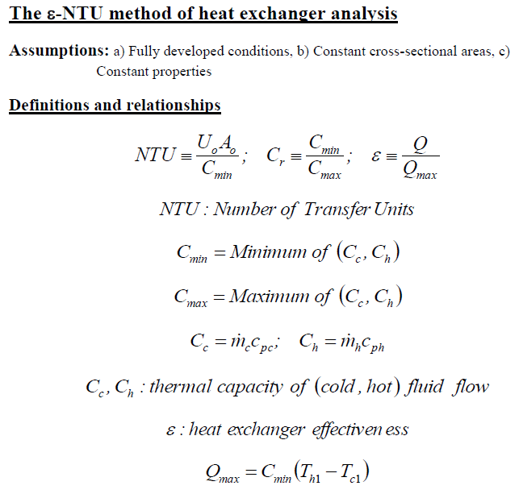
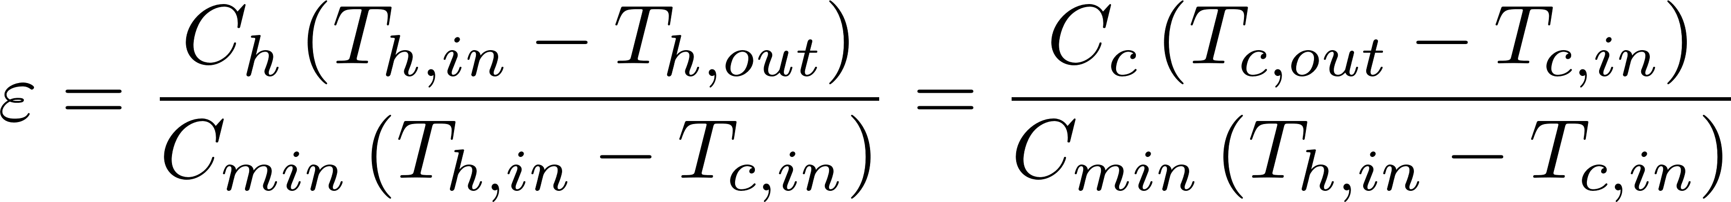
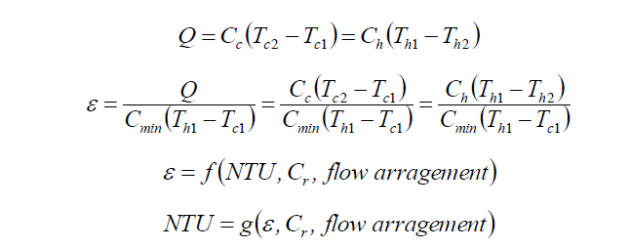

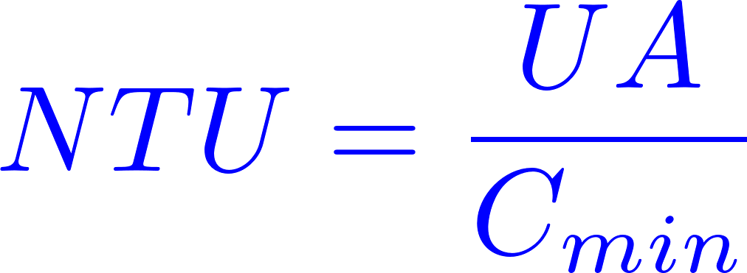
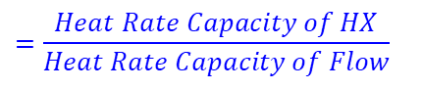
RATING CALCULATIONS – HXs
ε – NTU METHOD
ε – NTU method is used to calculate the rate of heat transfer in heat exchangers (especially parallel flow, counter current, and cross-flow exchangers) when there is insufficient information to calculate LMTD.
$ε=\frac{Actual heat transferred}{Maximum heat that could possibly be transferred from one stream to the other}$
Mathematically this is equal to:
Reason: The fluid with lower heat capacity will be the one that undergoes the maximum temperature change, i. e.,
$$=\frac{Heat Rate Capacity of HX}{Heat Rate Capacity of Flow}$$

Slide 23
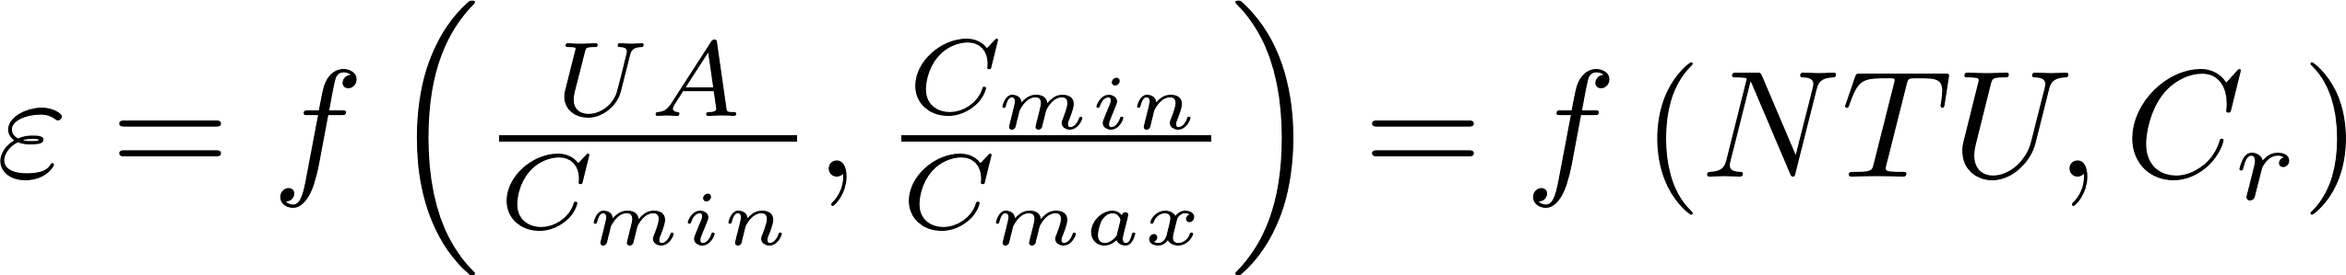
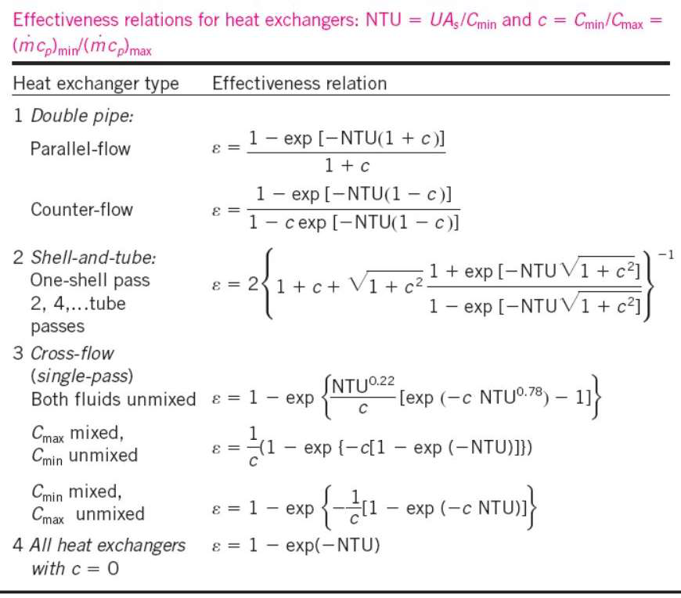
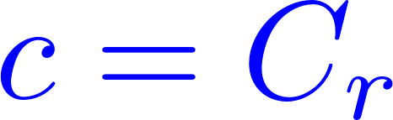
RATING CALCULATIONS – HXs
ε – NTU METHOD

Slide 24
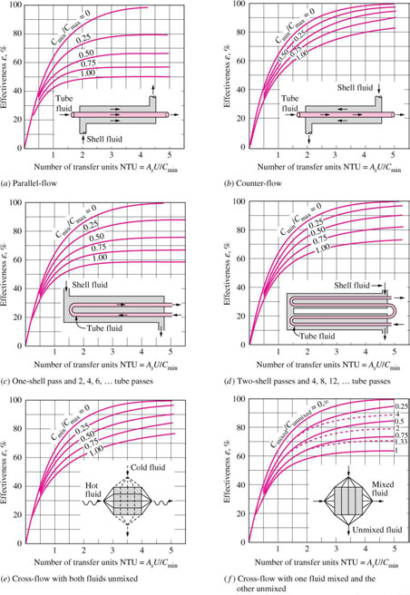
RATING CALCULATIONS – HXs
ε – NTU METHOD

Slide 25
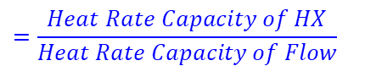
RATING CALCULATIONS – HXs
ε – NTU METHOD
$$=\frac{Heat Rate Capacity of HX}{Heat Rate Capacity of Flow}$$
For specified values of U and C_{min}, the value of NTU is a measure of the surface area A. Thus, the larger the NTU, the larger the heat exchanger.
The effectiveness of a heat exchanger is a function of the number of transfer units NTU and the capacity ratio C_{r}.
When all the inlet and outlet temperatures are specified, the size of the heat exchanger can easily be determined using the LMTD method.
Alternatively, it can be determined from ε – NTU method by first evaluating the effectiveness from its definition and then the NTU from the appropriate NTU relation.

Slide 26
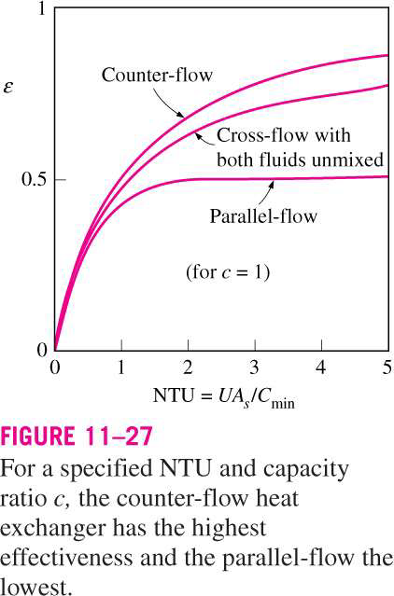
RATING CALCULATIONS – HXs
ε – NTU METHOD
◉ The value of the effectiveness ranges from 0 to 1.
◉ It increases rapidly with NTU for small values (up to about NTU = 1.5) but rather slowly for larger values. Therefore, the use of a HX with a large NTU (>3) and thus a large size cannot be justified economically, since a large increase in NTU in this case corresponds to a small increase in effectiveness.
◉ For a given NTU and capacity ratio c = C_{min} /C_{max}, the counterflow HX has the highest effectiveness, followed closely by the cross-flow HX with both fluids unmixed. The lowest effectiveness values are encountered in parallel-flow HX.

Slide 27
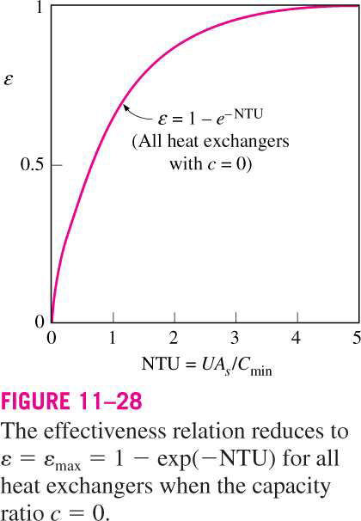
RATING CALCULATIONS – HXs
ε – NTU METHOD
◉ The effectiveness of a heat exchanger is independent of the capacity ratio c for NTU
values of less than about 0.3.
◉ The value of the capacity ratio c ranges between 0 and 1.
◉ For a given NTU, the effectiveness becomes a maximum for c = 0 (e.g., boiler, condenser) and a minimum for c = 1 (when the heat capacity rates of the two fluids are equal).

Slide 28
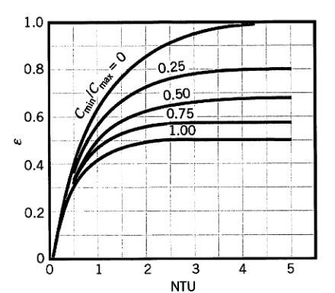
RATING CALCULATIONS – HXs
ASSIGNMENT
Q1. Consider the following parallel flow HX specification:
Cold flow enters at 40 °C, Cold heat capacity is C_{c} = 20000 W/K
Hot flow enters at 150 °C, Hot heat capacity is C_{h} = 10000 W/K
Area is 30 m², and Overall heat transfer coefficient is 500 W/m²K.
Determine the heat transfer rate and the exit temperatures.
Q2. Suppose we have the same problem as Q1, but A is unknown and we want exit temperature of the hot fluid to be 90°C. Then calculate A, from LMTD and ε-NTU method. How many tubes of 0.3 m diameter and 10 m length should be used?

Slide 29
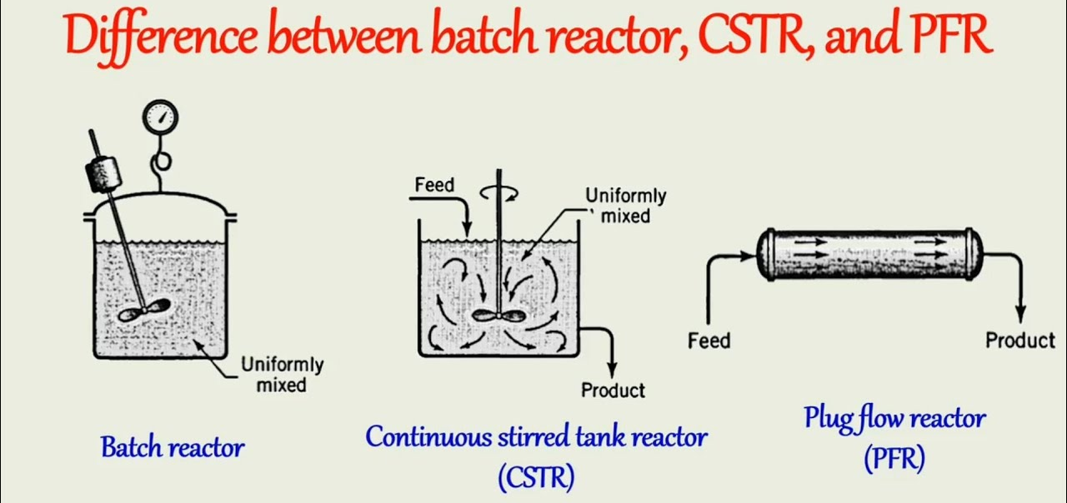
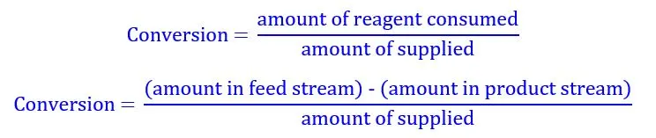
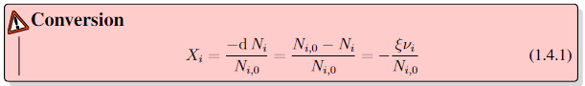
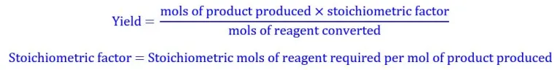
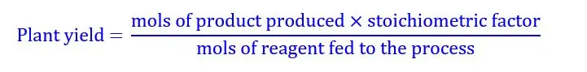
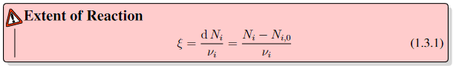
CHEMICAL REACTORS
A chemical reactor is an enclosed volume in which a chemical reaction takes place.
Conversion, Yield, Extent of Reaction
Conversion
Yield
Extent of reaction is a quantity that measures the extent to which the reaction has proceeded.
Source: Google Images

Slide 30
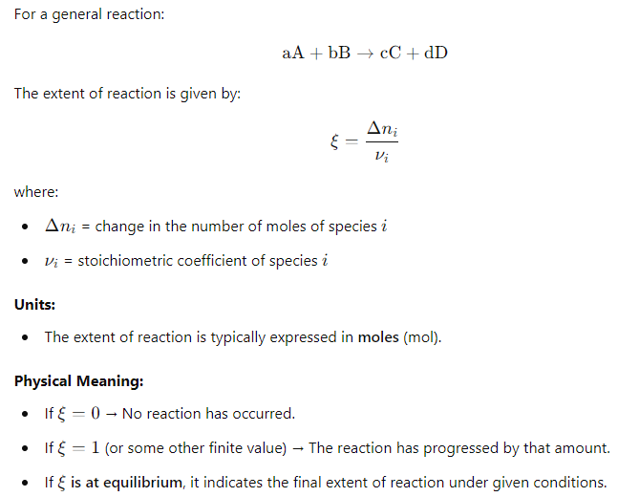
CHEMICAL REACTORS
A chemical reactor is an enclosed volume in which a chemical reaction takes place.
Extent of reaction
(negative for reactants, positive for products).
Source: Google Images

Slide 31
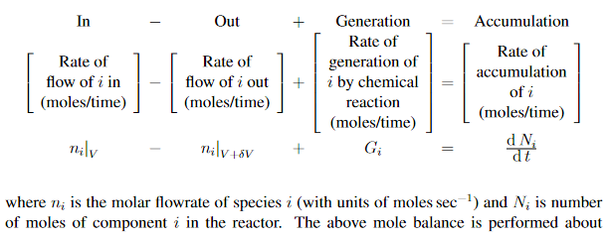
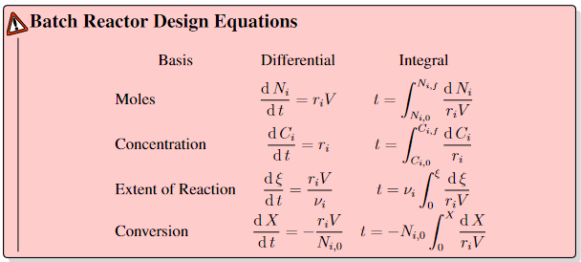
CHEMICAL REACTOR DESIGN
GENERAL MOLE BALANCE OF A REACTOR
Source: Google Images

Slide 32
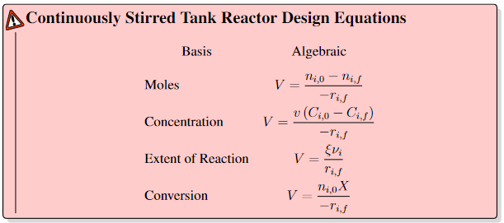
CHEMICAL REACTOR DESIGN
GENERAL MOLE BALANCE OF A REACTOR
Source: Google Images

Slide 33
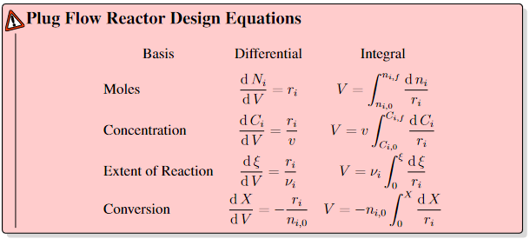
CHEMICAL REACTOR DESIGN
GENERAL MOLE BALANCE OF A REACTOR
Source: Google Images

Slide 34
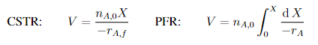
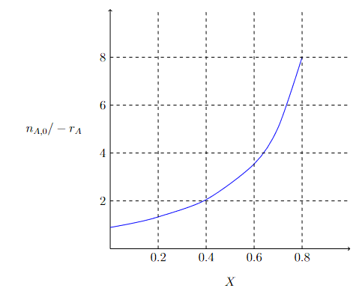


LEVENSPIEL PLOTS
Figure shows some real data for an isothermal reaction with conditions of T = 500 K, P = 8.2 atm, and n_{A0} = 0.4 mol s⁻¹. In order to size a reactor from experimental rate data, we first need to plot n_{A,0} / − r_{A} (m³) as a function of X (this plot is called a Levenspiel plot).
Source: Google Images

Slide 35


OPTIMIZATION OF REACTOR VOLUME
Source: Google Images

Slide 36


OPTIMIZATION OF REACTOR VOLUME
Putting CSTRs in series reduces the volume required.
An infinite number of CSTRs in series is equivalent to a PFR.
Putting PFRs in series is equivalent of a longer PFR.
Source: Google Images

Slide 37




MANY MORE PROCESS PLANT EQUIPMENTS …
Distillation Column
Vacuum Distillation Column
Source: Google Images

